Slide 1
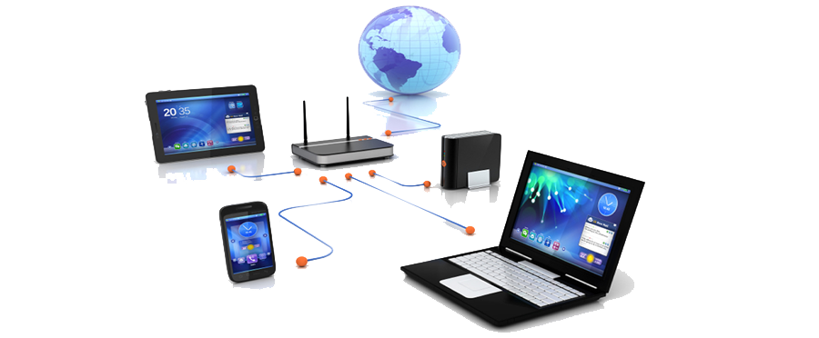
UART COMMUNICATION PROTOCOL

Slide 2
TABLE OF CONTENTS
What is communication
Serial and parallel communication
UART protocol
Working of UART
UART 8250 chip and Hardware registers
Programmable Interrupt controller 8259
Hardware flow of UART communication.
UART driver code
Applications
Advantages and Disadvantages
References

Slide 3
WHAT IS A COMMUNICATION ?
Exchanging information or data between two objects.
Objects may be a person or a device.
To have healthy communication, some parameters like language, speed, etc. must be matched.
In this we are going to talk about device communication.
This is done by transferring data from one device to another device.
In device communication there are some parameters to be matched, like communication parameters, communication protocol, synchronization, and baud rate.

Slide 4
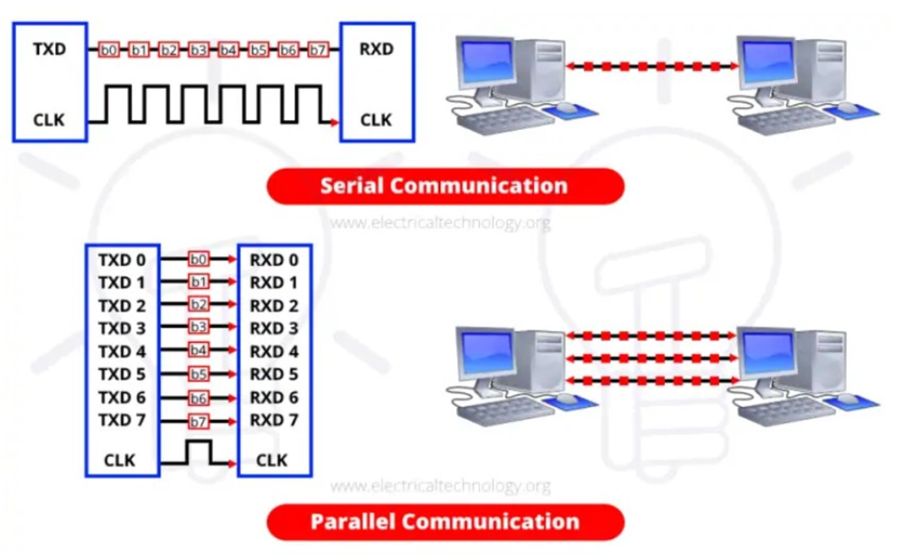
Contd..
In device communication data is transferred in form of bits.
This data is transferred through TTL signals from the device to the device.
Based on data transfer communication is of two types
Serial communication.
Parallel communication.
Based on these communication types there are communication protocols.

Slide 5
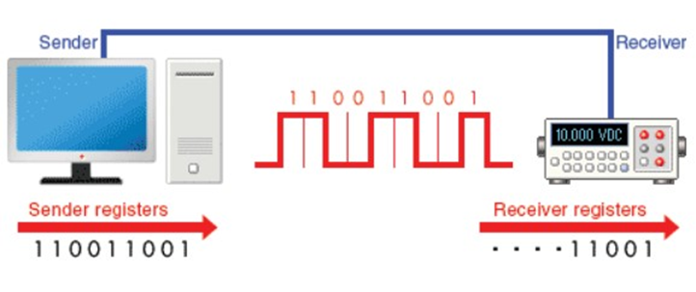
SERIAL COMMUNICATION
In serial communication data is transferred serially from one device to another.
And data is continuously sent and received one bit at a time.
For every single clock pulse one bit is transmitted from the transmitter.

Slide 6
Contd..
And for every single clock pulse one bit is received by the receiver.
In this only way of communication is possible at a time, it is half duplex.
It supports different communication protocols.
UART (universal asynchronous transmitter and receiver)
SPI( serial peripheral interface)
I2C (inter-integrated circuit)
RS-232 (recommended standard 232)
USB (universal serial bus)
CAN (controller area network)

Slide 7
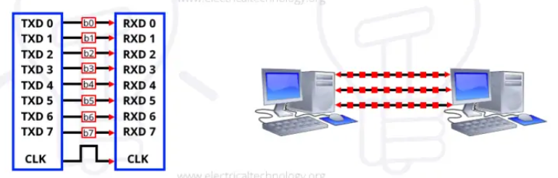
PARALLEL COMMUNICATION
Here data is transmitted parallelly.
It is a high-speed transfer protocol as it sends several data signals simultaneously for one single clock pulse.
It supports protocols like
PCI (peripheral component interconnect)
ISA (industry standard architecture bus)

Slide 8
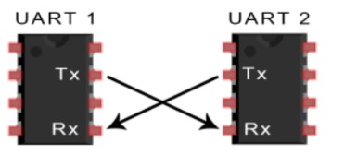
UART protocol
Uart protocol is a serial communication protocol.
A UART , universal asynchronous receiver/transmitter is responsible for performing the main task in serial communications with computers.
This device changes incoming parallel information to serial data which can be sent on a communication line.
A second UART can be used to receive the information.

Slide 9
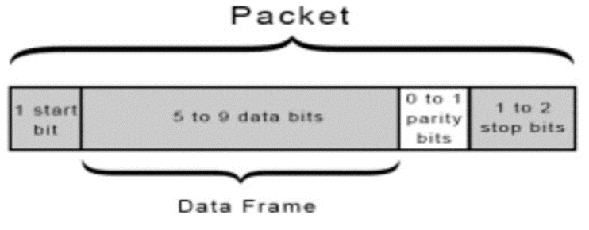
Contd..
UART transmits data asynchronously, as there is no clock signal to synchronize data bits.
Instead of clock signal transmitting UART adds some parameters like stop bit, parity bit, and stop bit to the data frame.
These bits define the beginning and end of the data packet so that receiving UART can know when to start reading bits.

Slide 10
Working of UART
Start bit: The first bit of a one-byte UART transmission. It indicates that the data line is leaving its idle state. The idle state is typically logic high, so the start bit is logic low.
The start bit is an overhead bit; this means that it facilitates communication between the receiver and the transmitter but does not transfer meaningful data.
Stop bit: The last bit of a one-byte UART transmission. Its logic level is the same as the signal’s idle state, i.e., logic high. This is another overhead bit.
Parity bit: An error-detection bit added to the end of the byte. There are two types—“odd parity” means that the parity bit will be logic high if the data byte contains an even number of logic-high bits, and “even parity” means that the parity bit will be logic high if the data byte contains an odd number of logic-high bits.

Slide 11
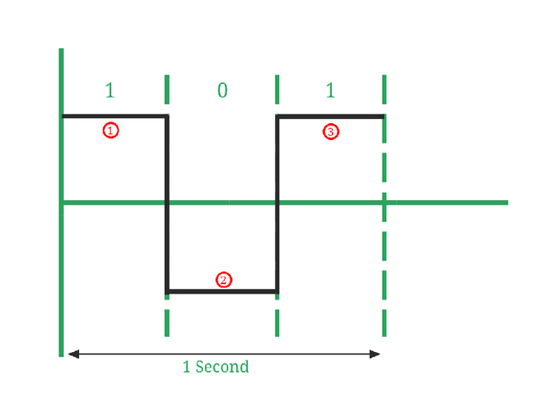
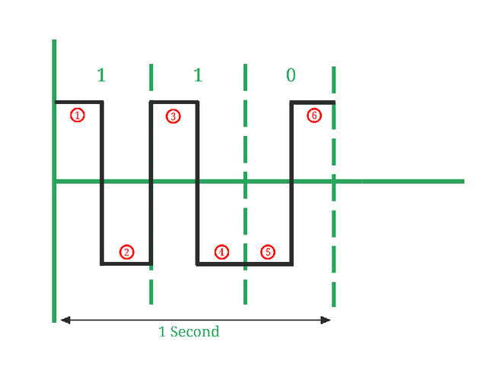
contd….
Baud rate: Baud rate is the rate at which the number of signal elements or changes to the signal occurs per second when it passes through a transmission medium. The higher the baud rate is the faster the data is sent/received.
Baud rate = number of signal elements / total time(sec).
It is a one-way communication half-duplex. The first bit that is received after the start bit is MSB.

Slide 12
UART 8250
8250 is manufactured by the National semiconductor corporation.
Firstly IBM used this 8250 in pc by integrating it into the chip.
8250 is a UART chip that is integrated with the processor in your x86 machine.
To transmit or receive data we have to initialize the registers present in it.
There are a total of 12 different registers that are mapped into 8 different port I/O locations.
There is more than one register that uses the same port locations and affects how the UART can be configured.

Slide 13
UART REGISTERS
Base address | DLAB | I/O Access | Abbrv. | Register NAme
+0 | 0 | Write | THR | Transmitter holding buffer
+0 | 0 | Read | RBR | Receive buffer
+0 | 1 | Read / Write | DLL | Divisor latch low byte
+1 | 0 | Read / Write | IER | Interrupt enable register
+1 | 1 | Read / Write | DLH | Divisor latch high byte
+2 | X | Read | IIR | Interrupt identification register
+2 | X | Write | FCR | Fifo control register
+3 | X | Read / Write | LCR | Line control register
+4 | X | Read / Write | MCR | Modem control register
+5 | X | Read | LSR | Line status register
+6 | X | Read | MSR | Modem status register
+7 | x | Read / Write | SR | Scratch register

Slide 14
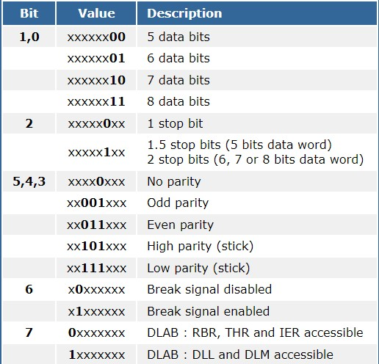
LINE CONTROL REGISTER
Line control register is used at initialization to set the communication parameters.
It has read and write operations.
It controls the accessibility of DLL and DLH registers.
These registers are mapped to the same I/O ports as the RBR, THR and IER registers.
First two bits are used to set the number of bits to be transferred.
Third bit is used to set the stop bit.
Next there are used to set the parity.
Last bit is DLAB bit which is used to set the baud rate.
When DLAB is high then only we can set the baud rate.
After setting the baud rate we have to clear the DLAB bit in the register.

Slide 15
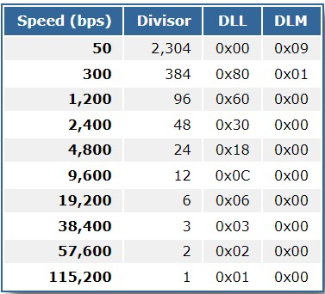
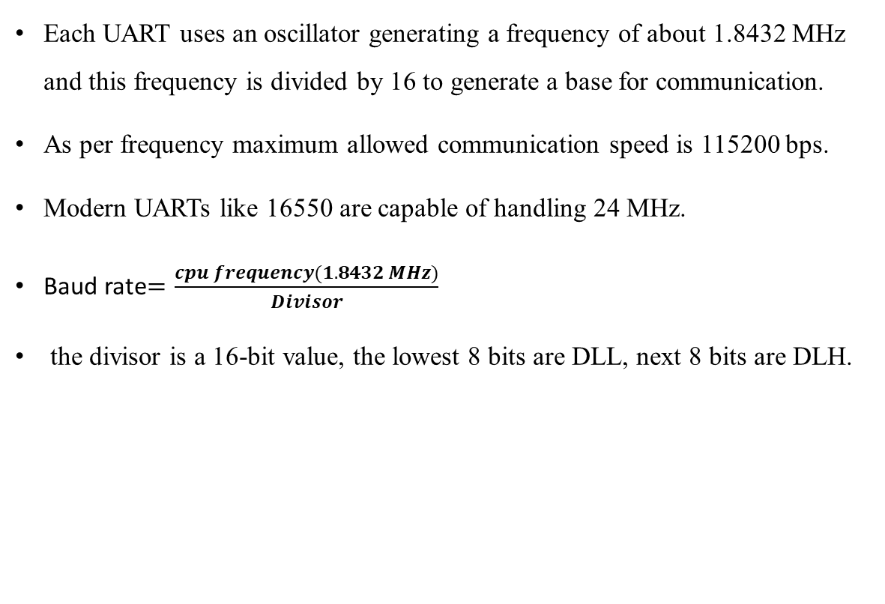
DLL and DLH
Each UART uses an oscillator generating a frequency of about 1.8432 MHz and this frequency is divided by 16 to generate a base for communication.
As per frequency maximum allowed communication speed is 115200 bps.
Modern UARTs like 16550 are capable of handling 24 MHz.
Baud rate$=\frac{cpu frequency(1.8432 MHz)}{Divisor}$
the divisor is a 16-bit value, the lowest 8 bits are DLL, next 8 bits are DLH.

Slide 16
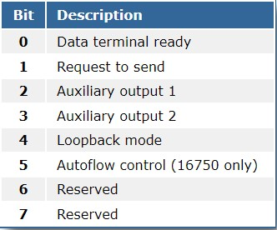
Modem control register
MCR register allows us to control hardware ,under software.
Offset need to be add is 4.
This register allows you to do hardware control under software control .
this will help to set four different wires on uart to any series of independent logic states.
It is mandatory most uart need to auxiliary output 2 set to a logic 1 to enable interrupts.
the Request to send(RTS) bit 1 and the data terminal ready (DTR)bit 0 are actually connected to the output of the pc on the db9 connector.

Slide 17
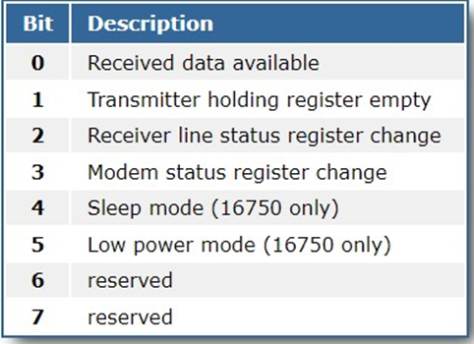
Interrupt enable register
Offset need to be added is +1
The permissions for this register are read and write. Both user and hardware can access these register.
This register helps to trigger and interrupt event with the hardware associated with the serial COM port.
The receive data interrupt is a way to let you know that there is some data waiting for you to pull off the UART.
The transmitter holding register empty interrupt indicates that the output buffer has finished sending everything that you pushed into the buffer.
Receiver line status register indicates that something in the lsr register probably changed.

Slide 18
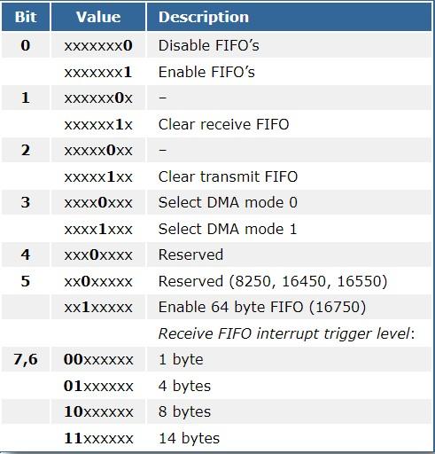
FIFOs
Offset need to be added is +2.
This is a relatively new register that was not a part of original 8250 UART implementation.
The purpose of this register is to control how the first in / first out buffers will behave on the chip
Writing a 0 to bit 0 disables the fifos, in essence turning the uart into compatibility mode

Slide 19
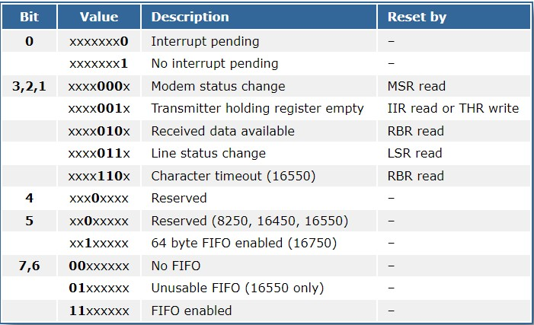
Interrupt Identification of register(IIR)
Offset to be added is +2
This register has read only permissions. only hardware can set the bits in this register
This register helps to identify what the unique characteristics that the uart we are using.
This register helps us to set the reserved condition for fifos.
Identification of why the uart triggered an interrupt
Identification of the uart chip itself.

Slide 20
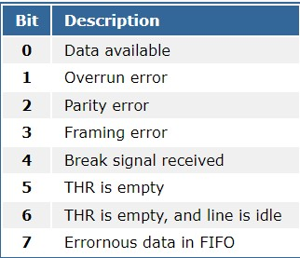
Line Status Register(LSR)
Offset to be added is +5.
The permissions for this register is read only
This register used primarily to give the information on possible error conditions that may exits within the UART.
Bit 7 refers to errors that are with the characters in the fifo. this reminds to clear the fifo.
Bit 6 is set to logical 1 if all characters have been transmitted and Bit 5 mainly tells that UART is capable of receiving more characters.

Slide 21
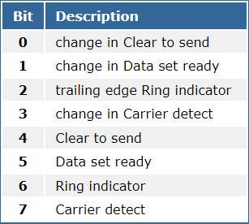
Modem Status Register(MSR)
Offset address to be added is +6.
There is read-only permission for this register.
This register informs your software about the current status of the modem.
Modem is nothing but asynchronous serial modem line control.

Slide 22
Transmit holding Buffer (THR) / Receiver Buffer(RBR)
Offset to be added is +0.
These two registers uses same memory.
The later versions of 8250 has incorporate some internal buffering of the data within the chip before it gets transmitted as serial data.
The base 8250 chip can only receive one byte at a time, while later chips like the 16550 chip will hold up to 16 bytes either to transmit or receive.
This can be used in multitasking environments where you have a computer doing many things.

Slide 23
About 8259 (interrupt handler)
8259 is a programmable interrupt controller(PIC).
The 8259A is designed to minimize the software and real time overhead in handling multi-level priority interrupts.
It the heart of the whole process of doing hardware interrupts.
External devices are directly connected to this chip. It has wires with each one labelled with a IRQ number.
The purpose of these chips is to help "prioritize" the interrupt signals and organize them in some orderly fashion. There is no way to predict when a certain device is going to "request" an interrupt, so often multiple devices can be competing for attention from the CPU.
The 8259A is designed to minimize the software and real time overhead in handling multi-level priority interrupts.

Slide 24
When an interrupt is occurred CPU will suspend the current process execution and start executing the interrupt raised by the external device.
We don’t know when an hardware will raise an interrupt. These interrupts are asynchronous.
The Programmable Interrupt Controller (PIC) functions as an overall manager in an Interrupt-Driven system environment.
It accepts requests from the peripheral equipment, determines which of the incoming requests is of the highest priority.
It compares whether the incoming request has a higher priority value than the level currently being serviced, and issues an interrupt to the CPU based on this determination.

Slide 25
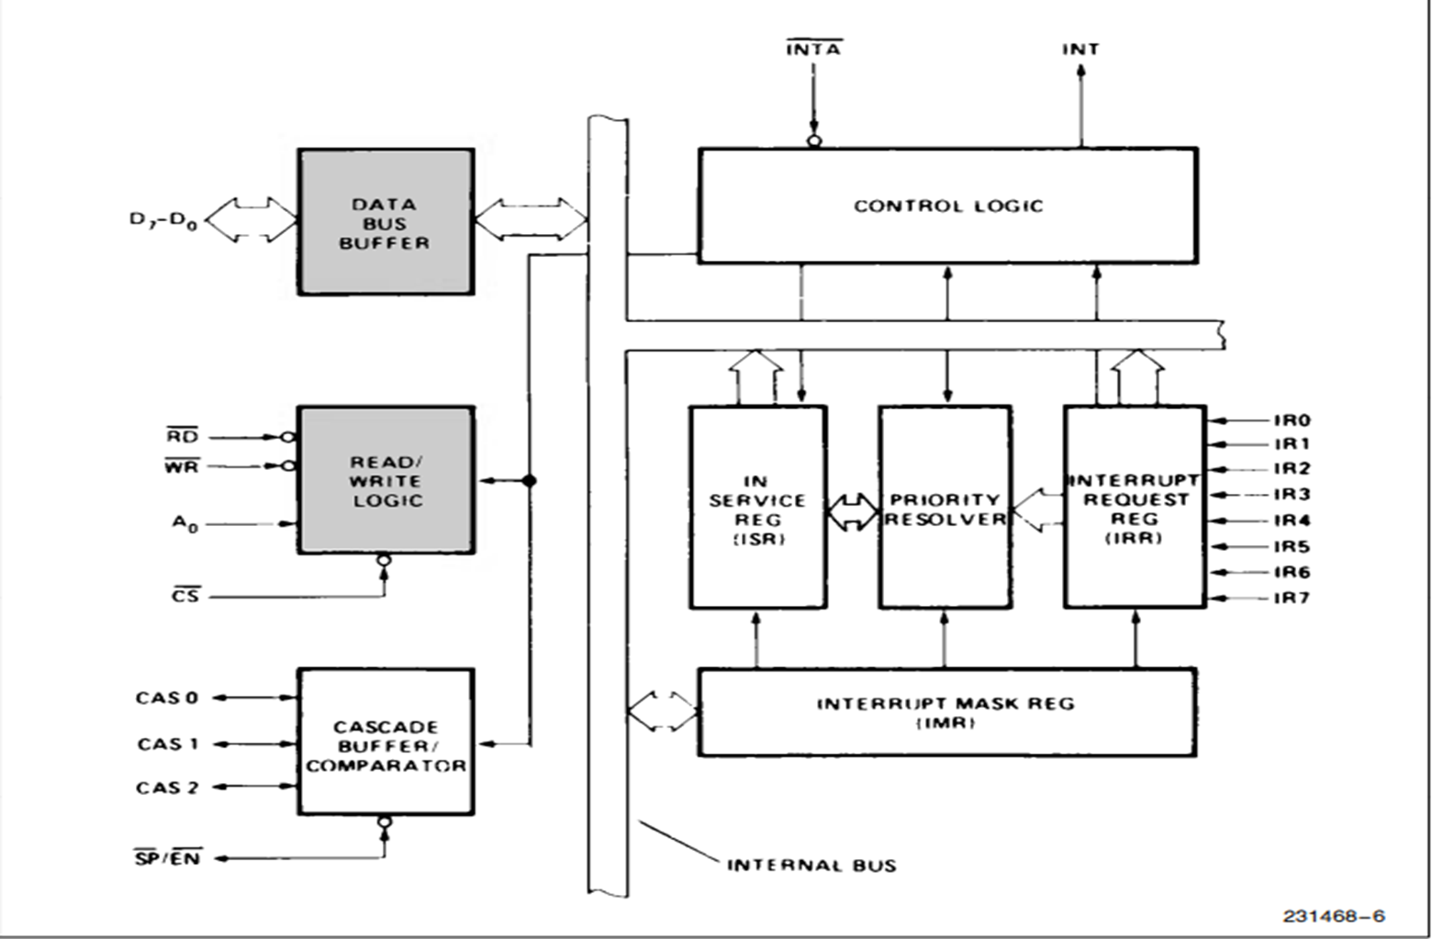
Programable interrupt controller

Slide 26
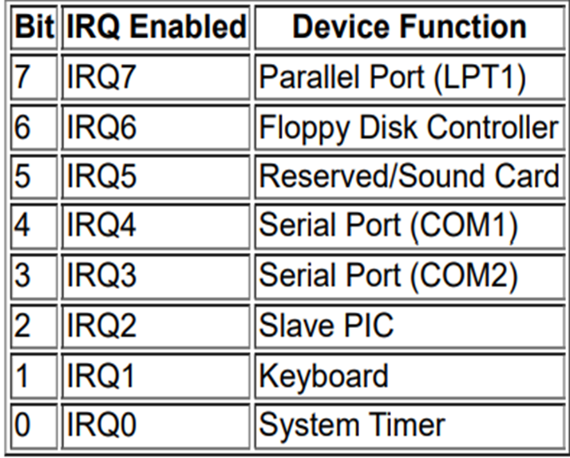
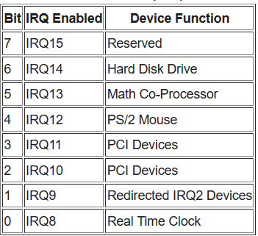
There are two types interrupt controllers.
Master interrupt controller (0x20)
Slave interrupt controller(0xA0)

Slide 27
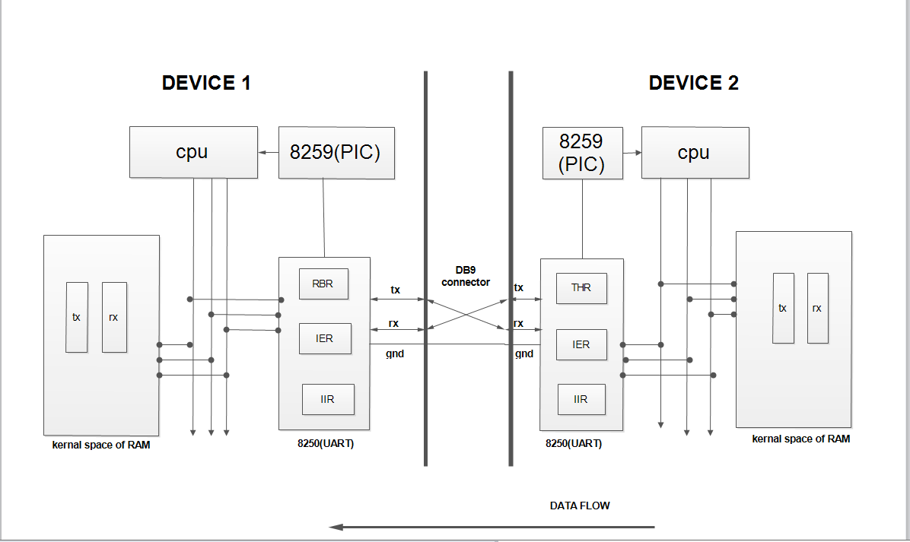
Hardware flow of UART in X-86 machine
Base address: 0x3f8
COM port 1
IRQ line 4
Transmitter side:
IIR→RI
IIR→TI
Txbuff → THR
Receciver side :
IIR→TI
IIR→RI
RBR → Rbuff
data
data
data
data
data
data
data
data
data
data

Slide 28
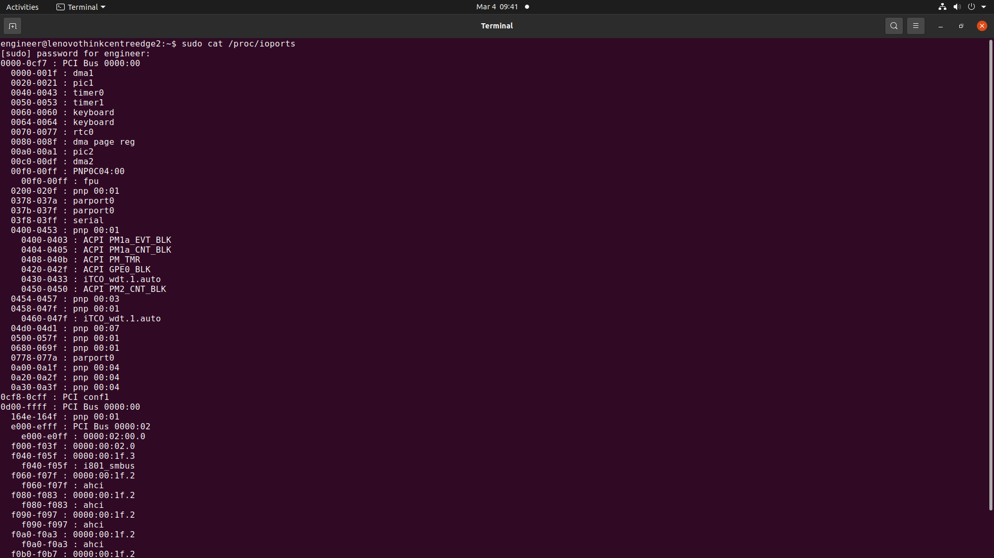

Slide 29
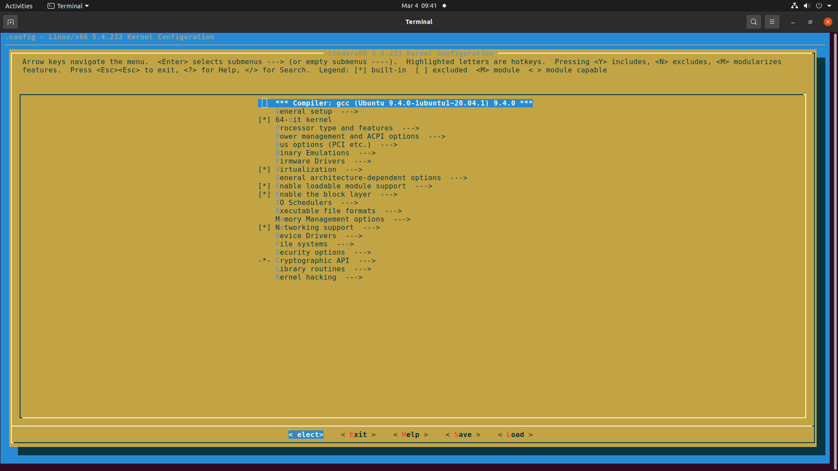
Adding driver to the kernel
Steps to disable the serial port and add our own driver to it.
In kernel compilation $ make menuconfig

Slide 30
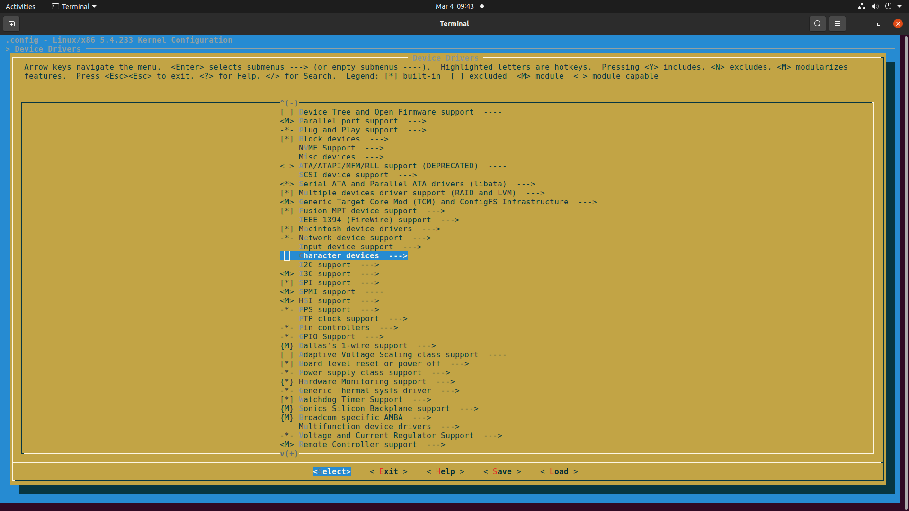

Slide 31
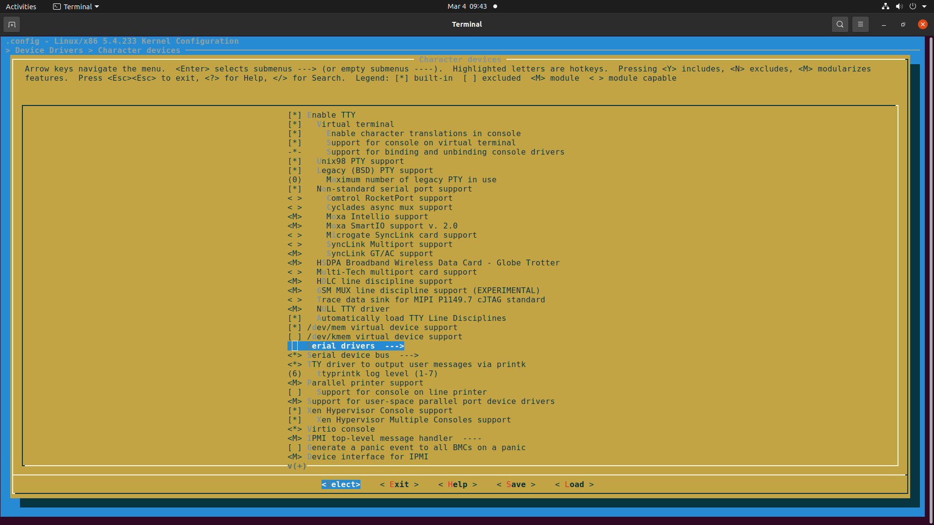

Slide 32
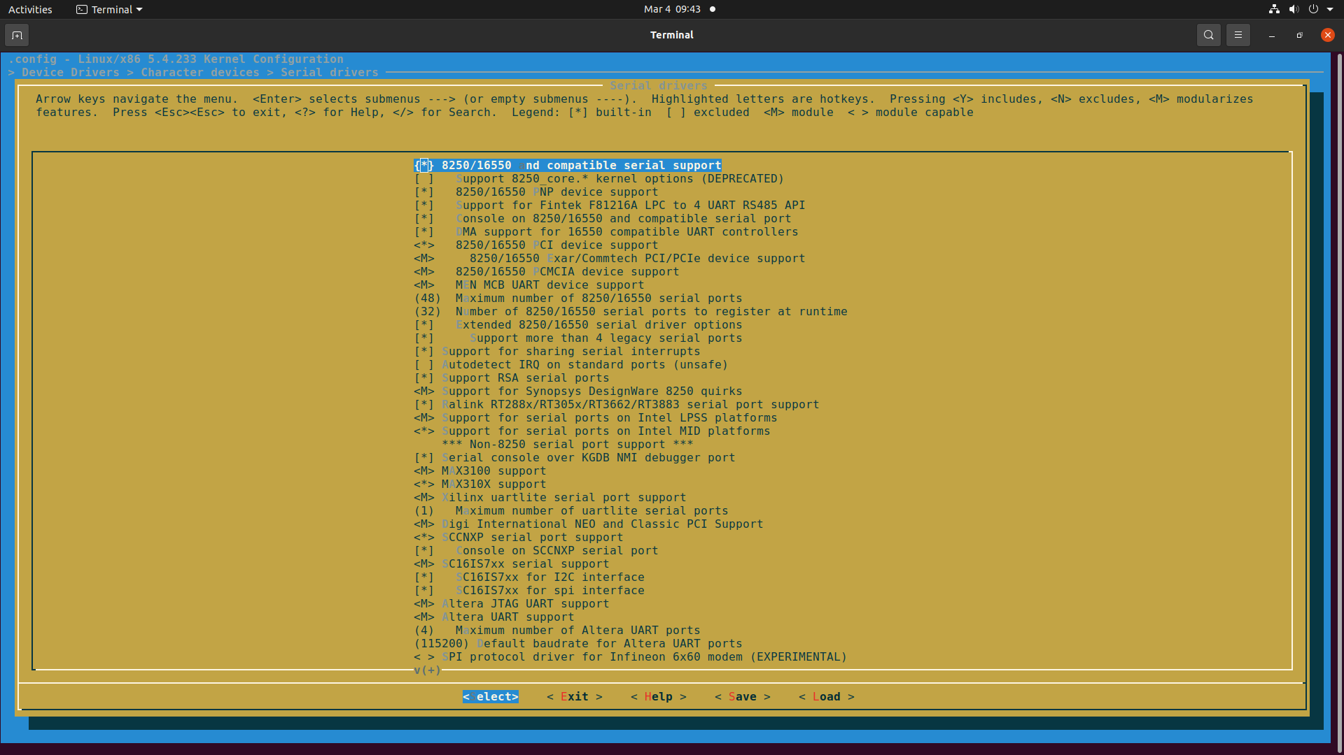

Slide 33
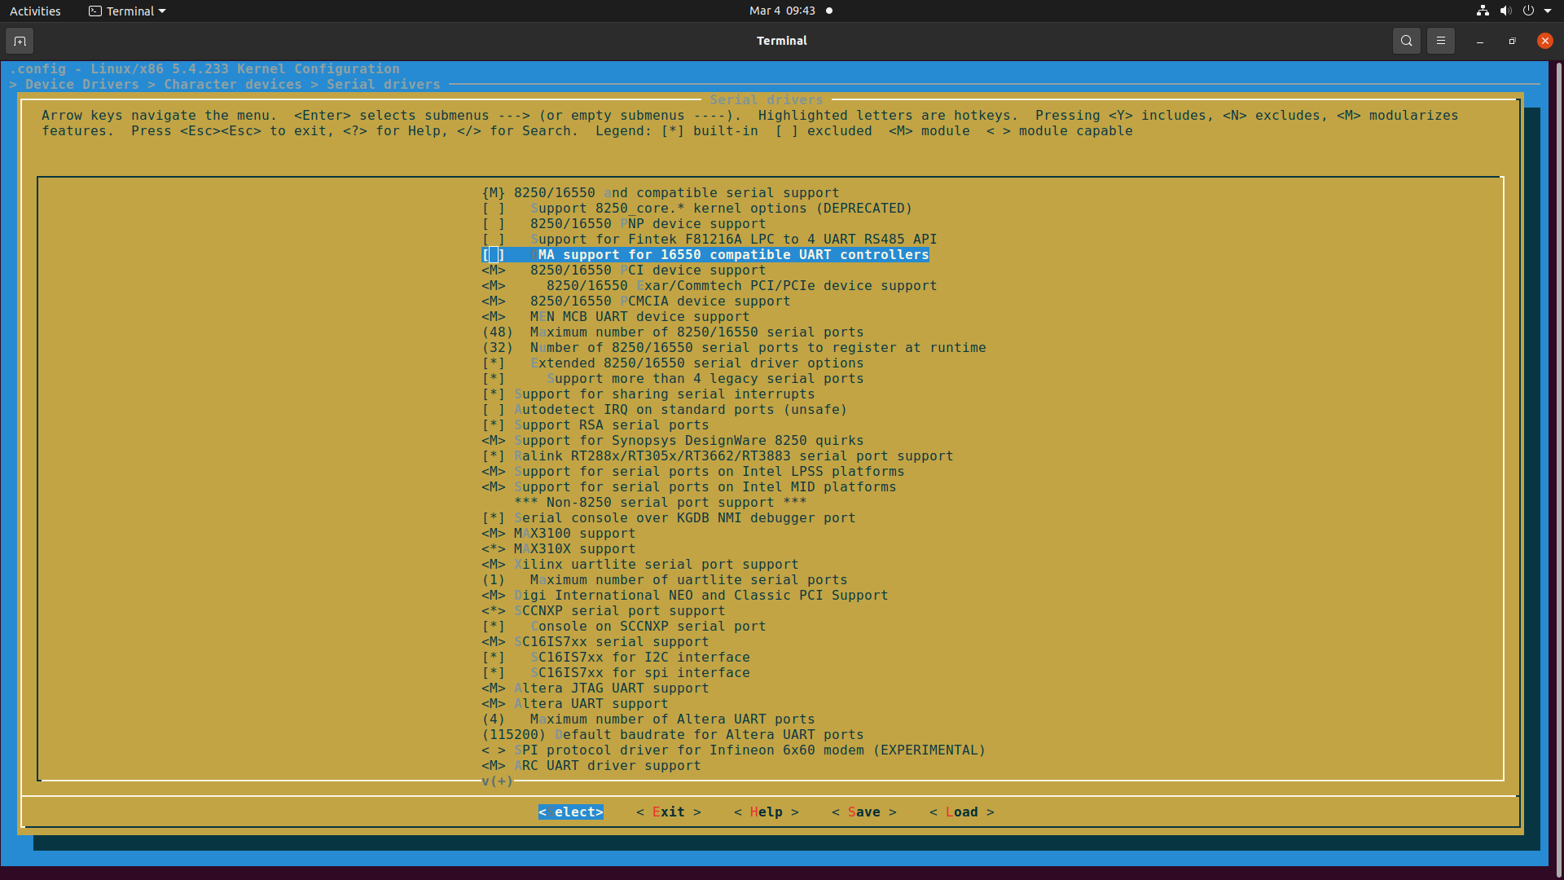

Slide 34
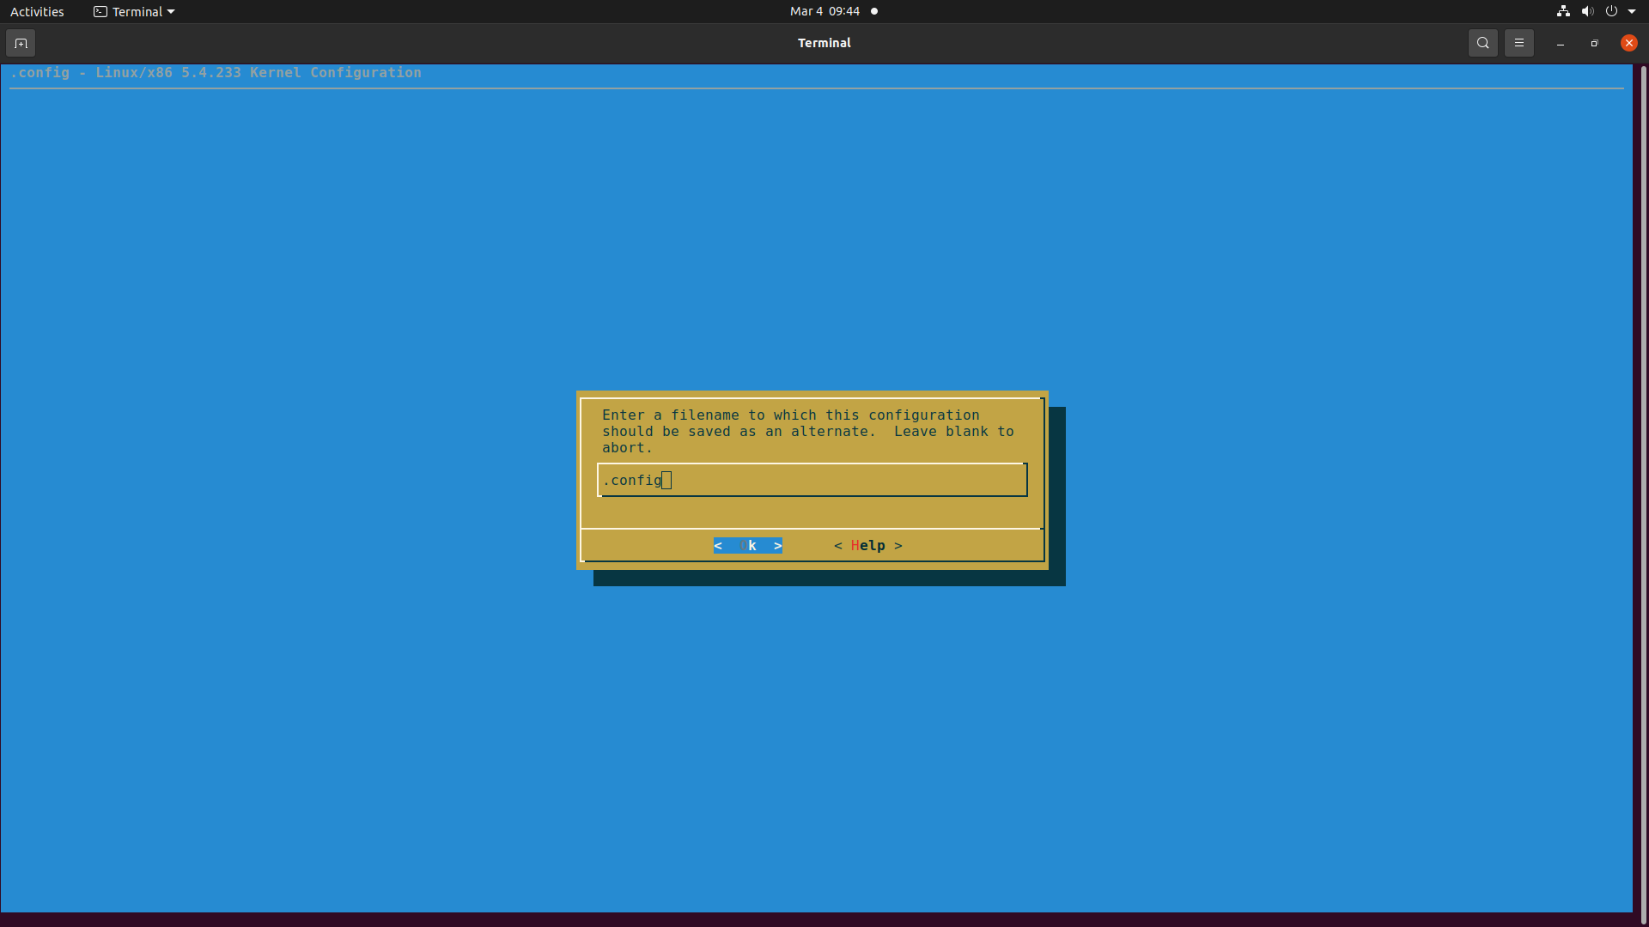

Slide 35
<<<<<<<<< UART Driver code>>>>>>>>>>>

Slide 36
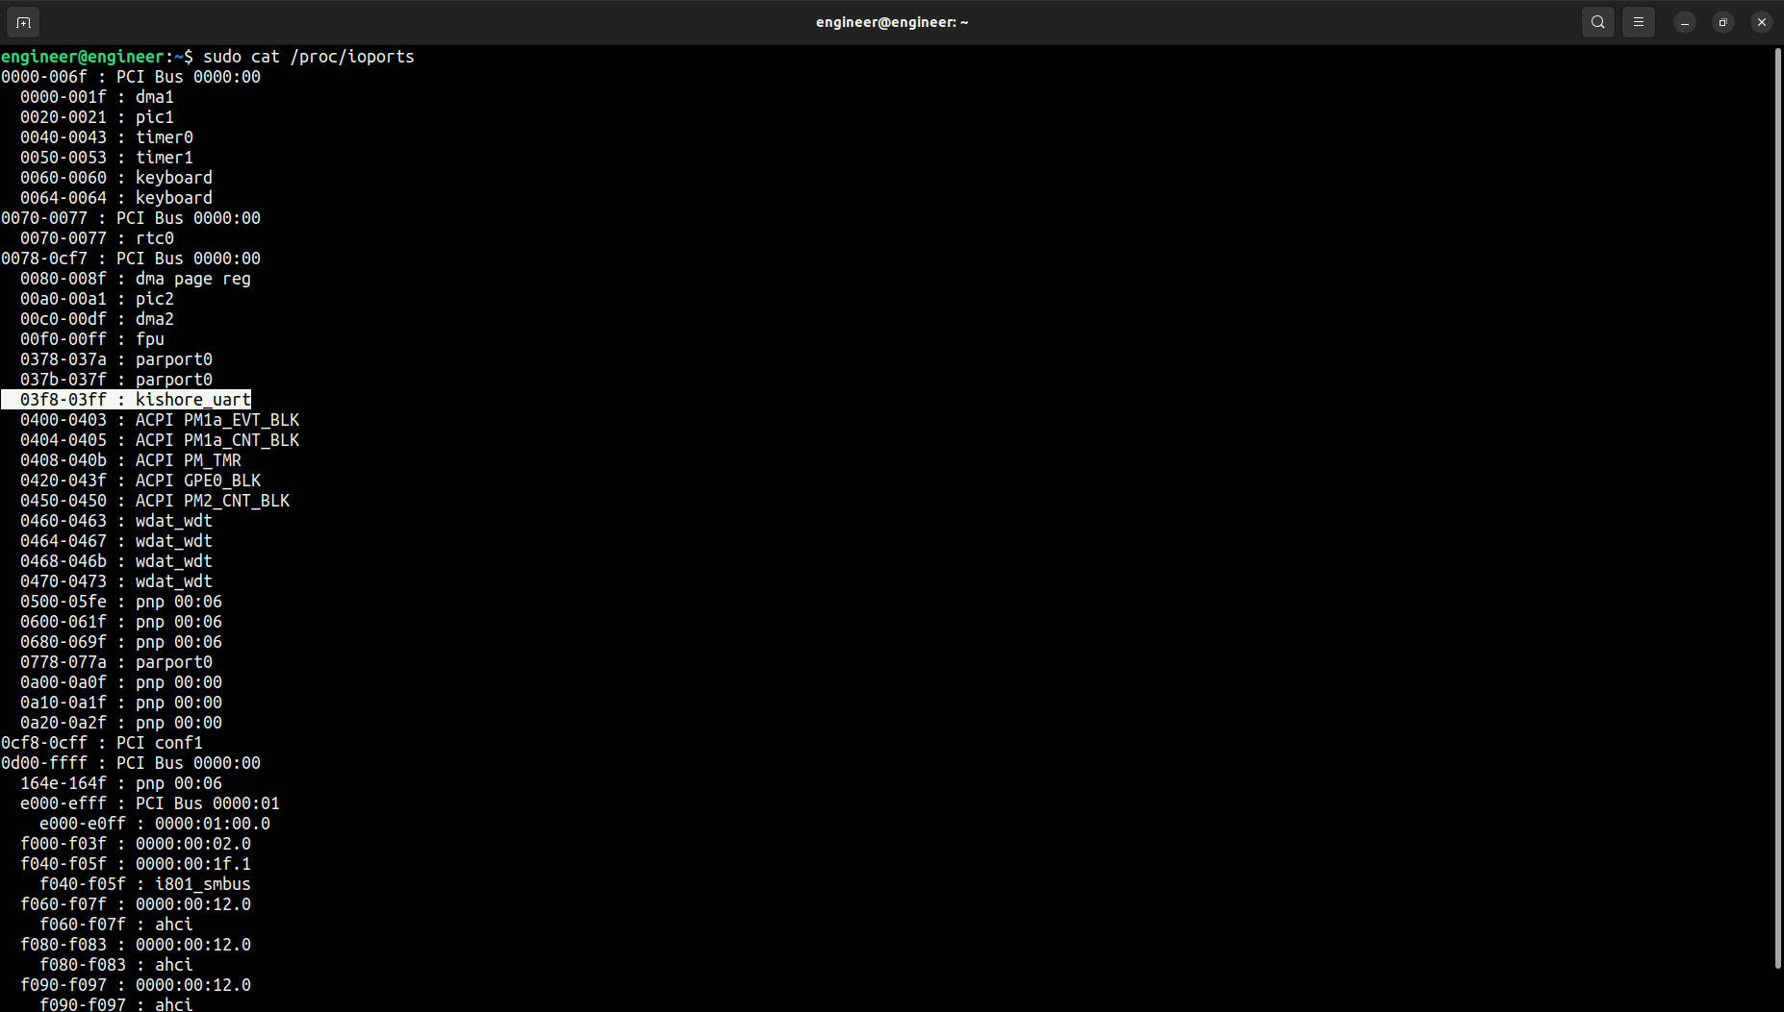

Slide 37
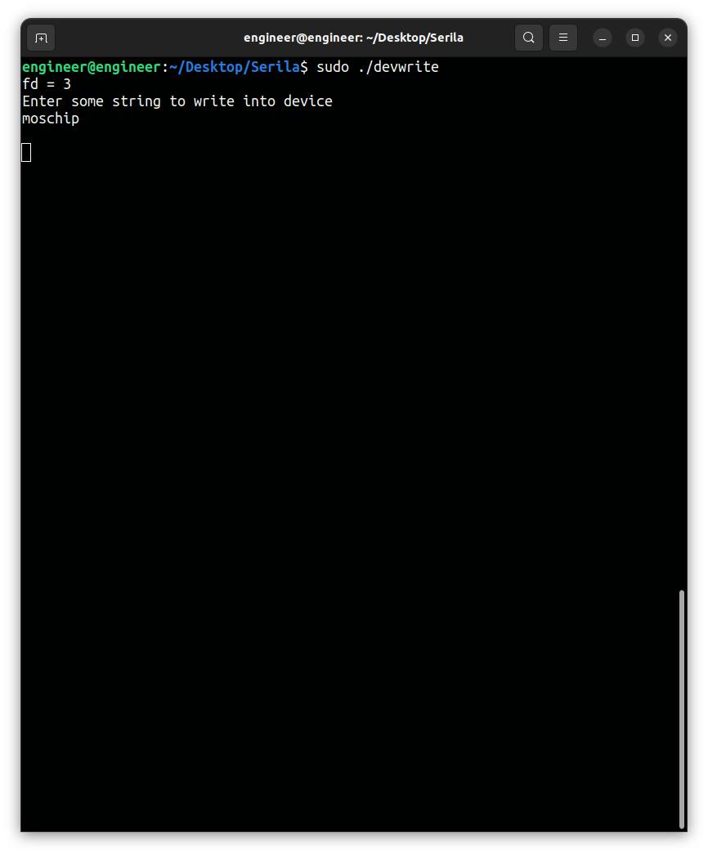
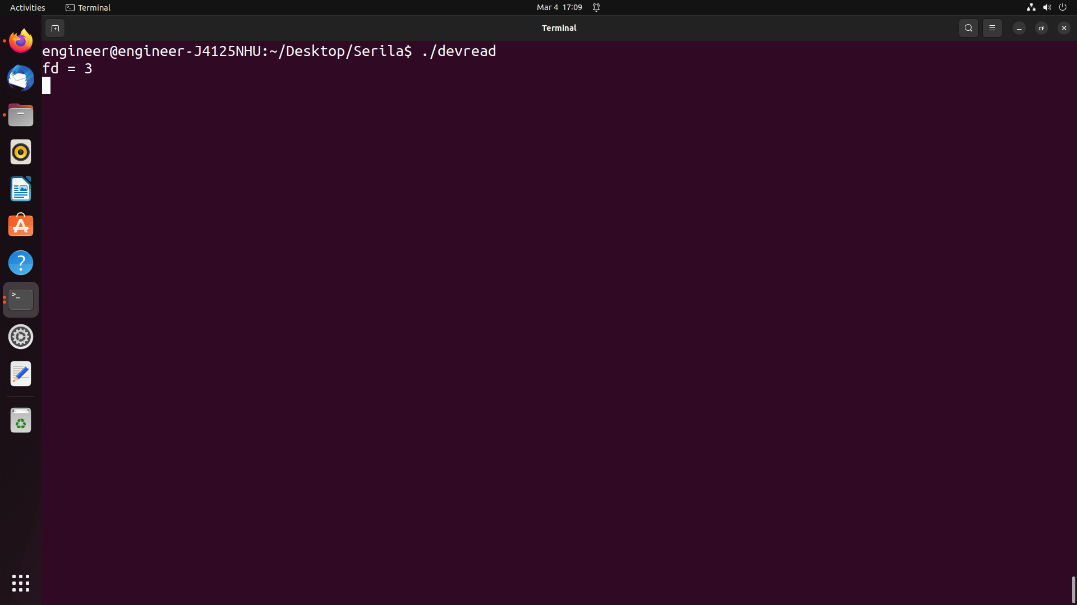
Entries and outputs..

Slide 38
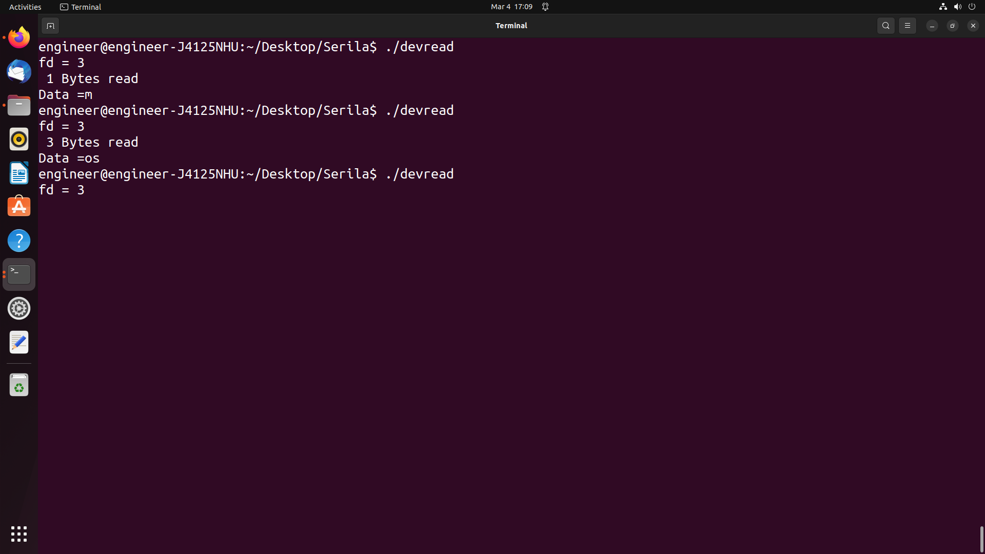
Output..

Slide 39
Applications
Generally UART is used in microcontrollers for exact requirements.
wireless communication
GPS units
Bluetooth modules and many other applications.

Slide 40
Advantages and Disadvantages
ADVANTAGES
DISADVANTAGES
Only uses two wires
No clock signal is necessary
It has a parity bit for error checking.
The structure of the data packet can be as long as both sides are set up for it.
The size of the data frame is limited to a maximum of 9 bits.
It doesn’t support multiple slave or multiple master systems.
The baud rates of each UART must be within 10% of each other.

Slide 41
References
Referred from these hyperlinks……
https://www.lammertbies.nl/comm/info/serial-uart
https://en.wikibooks.org/wiki/Serial_Programming/8250_UART_Programming
https://www.circuitbasics.com/basics-uart-communication/

Slide 42
THANK YOU…...

